Slide 1
Short Keras Introduction
Dr. U. Michelucci umberto.Michelucci@hslu.ch

Slide 2

TensorFlow 2.0

Slide 3

TensorFlow 1.x/2.x
An open source Deep Learning library
>1,800 contributors worldwide
Apache 2.0 license
Released by Google in 2015
TensorFlow 2.0
Easier to learn and use
For beginners and experts
Available today

Slide 4
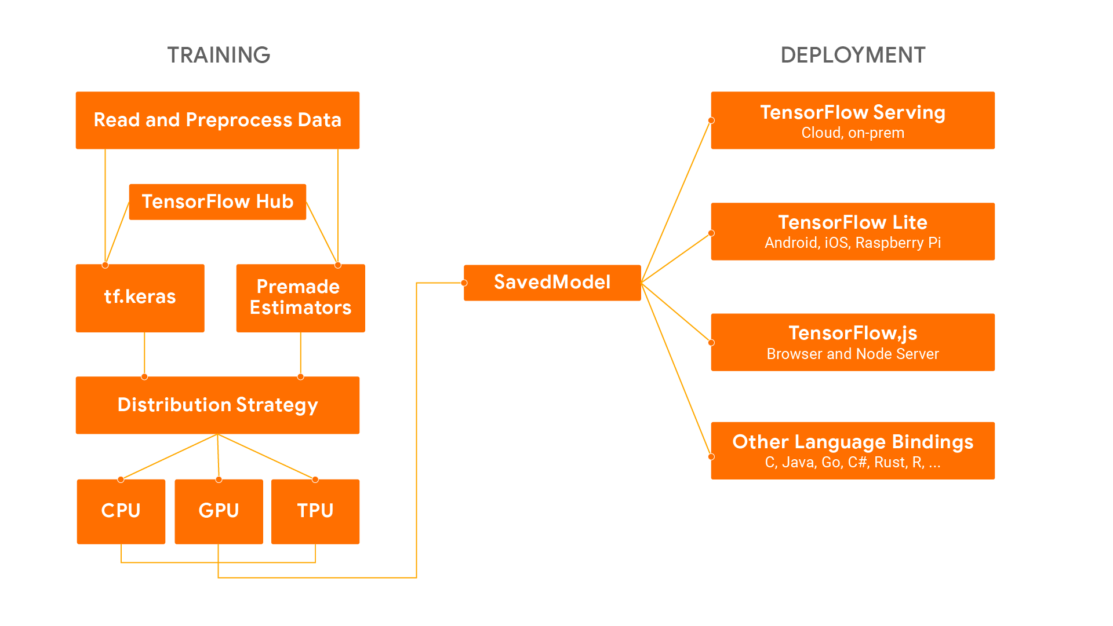
TensorFlow architecture
Source: Getting Started with TensorFlow 2.0 presentation Google I/O 2019

Slide 5
Training Workflow
Data Ingestion and Transformation
Model Building
Training
Saving
tf.data
Feature Columns
Keras
Premade Estimators
Custom
Eager Execution
Autograph
Distribution Strategy
Tensorboard
SavedModel
Source: Getting Started with TensorFlow 2.0 presentation Google I/O 2019
Notes:
Here’s how these powerful API components fit together for the entire training workflow
With tf.data for data ingestion and transformation
Keras and premade estimators for model building
Training with eager execution and graphs
And finally packaging for deployment with SavedModel

Slide 6
TensorFlow 2.0
2.x

Slide 7
What is new in TF2.o
Easy model building with Keras and eager execution (activated by default in TF2.0).
Robust model deployment in production on any platform.
Powerful experimentation for research.
Simplifying the API by cleaning up deprecated APIs and reducing duplication (relevant in case you have code developed in TensorFlow 1.X and you need to convert it)
Load your data using tf.data. Training data is read using input pipelines which are created using tf.data.
Build, train and validate your model with tf.keras, or use Premade Estimators.
TensorFlow Hub.
Run and debug with eager execution, then use tf.function for the benefits of graphs.
Use Distribution Strategies for distributed training.
hardware accelerators like CPUs, GPUs, and TPUs; you can enable training workloads to be distributed to single-node/multi-accelerator as well as multi-node/multi-accelerator configurations, including TPU Pods.
Export to SavedModel. TensorFlow will standardize on SavedModel as an interchange format for TensorFlow Serving, TensorFlow Lite, TensorFlow.js, TensorFlow Hub, and more.
Tensorflow Datasets

Slide 8
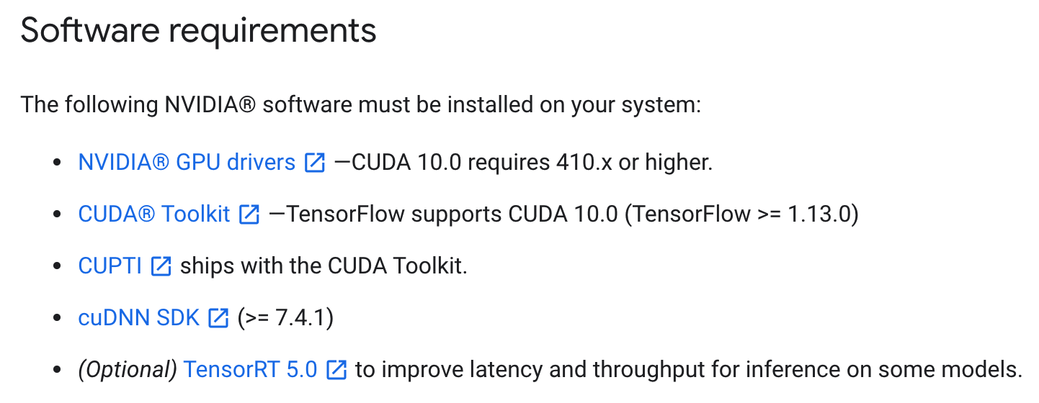
tensorflow-gpu version dependencies
Source: TF documentation

Slide 9
Check the installed version
import tensorflow as tf
print(tf.__version__)
When you change TF version you need to restart the runtime in Google Colab

Slide 10
TensorFlow 2.0
Usability
tf.keras as the recommended high-level API.
Eager execution by default.
>>> tf.add(2, 3) <tf.Tensor: id=2, shape=(), dtype=int32, numpy=5>
Source: Getting Started with TensorFlow 2.0 presentation Google I/O 2019
Notes:
When we created TensorFlow 2.0, the biggest focus was on usability.
We have adopted Keras is the high-level API for TensorFlow, and we have integrated it tightly into TensorFlow. Keras gives you a clear path to building models, deploying models with a well-established API.
The other big change in TensorFlow 2.0 is the switch to eager execution. Traditional 1.x TensorFlow used a declarative style that was dissonant with the surrounding Python.
In TensorFlow 2.0, TensorFlow behaves like the surrounding Python. <click> If you add two numbers, you get a number back, immediately.
But you still get all the benefits of having a graph -- robust program serialization and deployment, easy distributed computation, optimizations, and compatibility.

Slide 11
TensorFlow 2.0
Clarity
Remove duplicate functionality
Consistent, intuitive syntax across APIs
Compatibility throughout the TensorFlow ecosystem
Source: Getting Started with TensorFlow 2.0 presentation Google I/O 2019
Notes:
TensorFlow 2.0 is a major release, and we have taken the opportunity to clean up. A lot.
TensorFlow had a lot of duplicate functionality that was confusing. Especially if it behaved slightly differently.
In TensorFlow 2.0, we reorganized and consolidated the API.
We made sure the APIs look and feel consistent.
This is not only about TensorFlow itself. TensorFlow has evolved into a large ecosystem of tools and products, and we have spent a lot of effort to align their interfaces as well.
We have defined exchange formats that work everywhere, and we are making sure you can travel smoothly through all parts of the ecosystem.

Slide 12
TensorFlow 2.0
Flexibility
Full lower-level API.
Internal ops accessible in tf.raw_ops
Inheritable interfaces for variables, checkpoints, layers.
Source: Getting Started with TensorFlow 2.0 presentation Google I/O 2019
Notes:
TensorFlow 2.0 retains and expands the flexibility that have made TensorFlow successful.
TensorFlow 2.0 is easier then ever to build upon. We have created a more complete low-level API, and now export all ops that are used internally. This allows users to build on internals to TensorFlow without having to rebuild TensorFlow.
And we provide inheritable interfaces for crucial concepts such as variables, checkpoints.
This allows framework authors to build on top of TensorFlow while maintaining interoperability with other parts of the ecosystem.
So let’s take a look at that:

Slide 13
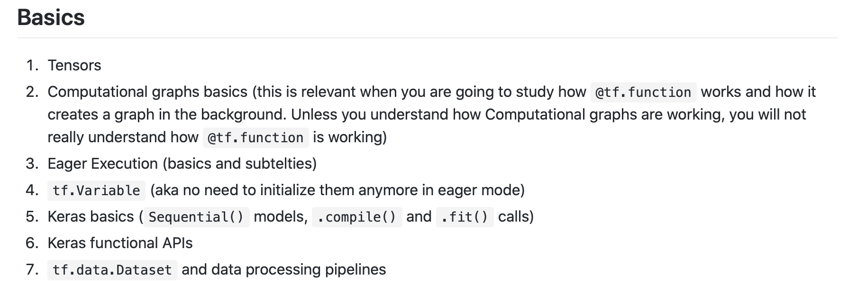
How to study TF2.0
https://github.com/michelucci/TensorFlow20-Notes/blob/master/howto_study_TF20.md

Slide 14
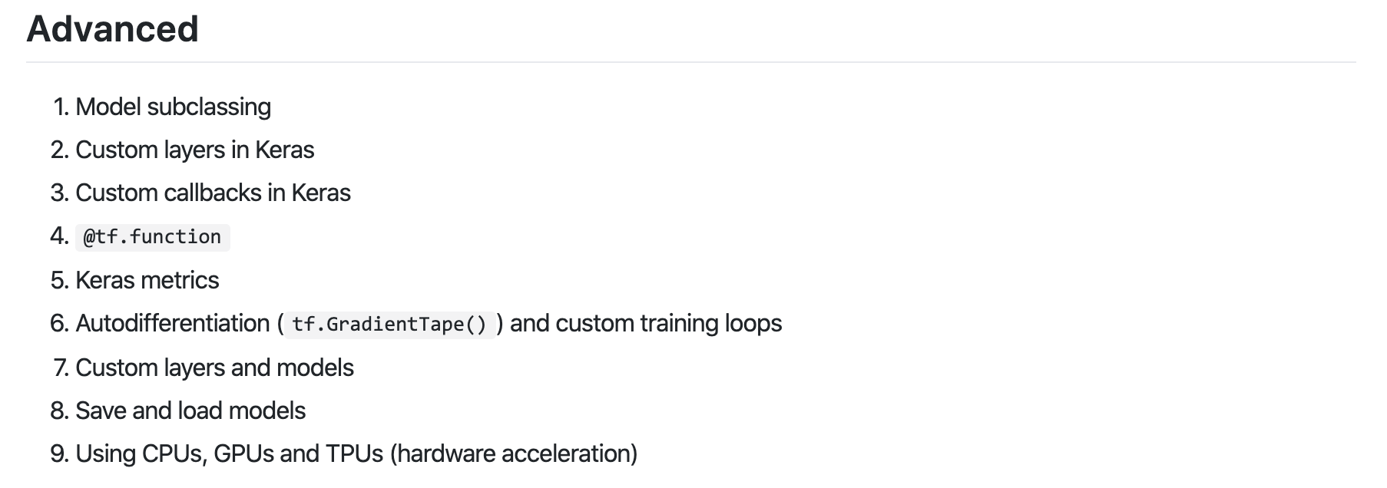
How to study TF2.0
https://github.com/michelucci/TensorFlow20-Notes/blob/master/howto_study_TF20.md

Slide 15
Use a built-in training loop...
model.fit(x_train, y_train, epochs=5)

Slide 16
Keras

Slide 17


KERAS: high level API

Slide 18
Keras.io (Reference implementation)
TensorFlow implementation
import keras
from tensorflow import keras
TensorFlow’s implementation (a superset, built-in to TF)

Slide 19
For beginners
Model definition
model = tf.keras.models.Sequential(...)
Model compilation
model.compile(...)
Model fitting
model.fit(...)

Slide 20
Sequential() model
model = tf.keras.models.Sequential([
tf.keras.layers.Flatten(),
tf.keras.layers.Dense(512, activation='relu'),
tf.keras.layers.Dropout(0.2),
tf.keras.layers.Dense(10, activation='softmax')
])
A sequence of layers stacked one after the other

Slide 21
Sequential() model - beginners
model = tf.keras.models.Sequential([
tf.keras.layers.Flatten(),
tf.keras.layers.Dense(512, activation='relu'),
tf.keras.layers.Dense(10, activation='softmax')
])
model.compile(optimizer='adam',
loss='sparse_categorical_crossentropy',
metrics=['accuracy'])
model.fit(x_train, y_train, epochs=5)
model.evaluate(x_test, y_test)

Slide 22
Sequential() model - experts
class MyModel(tf.keras.Model): def __init__(self, num_classes=10): super(MyModel, self).__init__(name='my_model') self.dense_1 = layers.Dense(32, activation='relu') self.dense_2 = layers.Dense(num_classes,activation='sigmoid') def call(self, inputs): x = self.dense_1(inputs) return self.dense_2(x)

Slide 23
Sequential() model

Slide 24
Sequential() model
The Sequential model is a linear stack of layers.
You can create a Sequential model by passing a list of layer instances to the constructor:
from keras.models import Sequential
from keras.layers import Dense, Activation
model = Sequential([
Dense(32, input_shape=(784,)),
Activation('relu'),
Dense(10),
Activation('softmax'),
])

Slide 25
Sequential() model
You can also simply add layers via the .add() method
model = Sequential()
model.add(Dense(32, input_dim=784))
model.add(Activation('relu'))

Slide 26
Compilation
Before training a model, you need to configure the learning process
model.compile(optimizer='rmsprop',
loss='categorical_crossentropy',
metrics=['accuracy'])

Slide 27
Training
Keras models are trained on Numpy arrays of input data and labels.
model.fit(x_train, y_train, epochs=5)

Slide 28
Layers in Keras

Slide 29
keras.layers
Most used
from keras.layers import Dense, Conv2D, MaxPooling2D, Dropout, Flatten
keras.layers.Dense
keras.layers.Conv2D
keras.layers.MaxPooling2D
keras.layers.Dropout
keras.layers.Flatten

Slide 30
Example of custom layer
class Linear(layers.Layer): def __init__(self, units=32, input_dim=32): super(Linear, self).__init__() w_init = tf.random_normal_initializer() self.w = tf.Variable(initial_value=w_init(shape=(input_dim, units), dtype='float32'), trainable=True) b_init = tf.zeros_initializer() self.b = tf.Variable(initial_value=b_init(shape=(units,), dtype='float32'), trainable=True) def call(self, inputs): return tf.matmul(inputs, self.w) + self.b x = tf.ones((2, 2)) linear_layer = Linear(4, 2) y = linear_layer(x)

Slide 31
Custom callback classes

Slide 32
Introduction
A custom callback is a powerful tool to customize the behavior of a Keras model during training, evaluation, or inference, including reading/changing the Keras model.
“In Keras, Callback is a python class meant to be subclassed to provide specific functionality, with a set of methods called at various stages of training (including batch/epoch start and ends), testing, and predicting. “
Source: https://www.tensorflow.org/guide/keras/custom_callback

Slide 33
Custom Callback methods
on_train_begin: Called at the beginning of training
on_train_end: Called at the end of training
on_epoch_begin: Called at the start of an epoch
on_epoch_end: Called at the end of an epoch
on_batch_begin: Called right before processing a batch
on_batch_end: Called at the end of a batch

Slide 34
Example of Callback
Callback during training
class CustomCallback1(keras.callbacks.Callback): def on_epoch_end(self, epoch, logs={}): print ("Just finished epoch", epoch) print (logs) return
CC1 = CustomCallback1() model.fit(train_images, train_labels, epochs = 2,validation_data = (test_images,test_labels), callbacks = [CC1]) >>> {'val_loss': 0.2545496598124504, 'val_acc': 0.9244, 'loss': 0.05098680723309517, 'acc': 0.9878}

Slide 35
Example of Callback
Frequency of logging
class CustomCallback3(keras.callbacks.Callback):
def on_epoch_end(self, epoch, logs={}):
print ("Just finished epoch", epoch)
print ('Loss evaluated on the validation dataset =',logs.get('val_loss'))
print ('Accuracy reached is', logs.get('acc')) return
>>> Just finished epoch 0
>>> Loss evaluated on the validation dataset = 0.2546206972360611
if (epoch % 10 == 0):

Slide 36
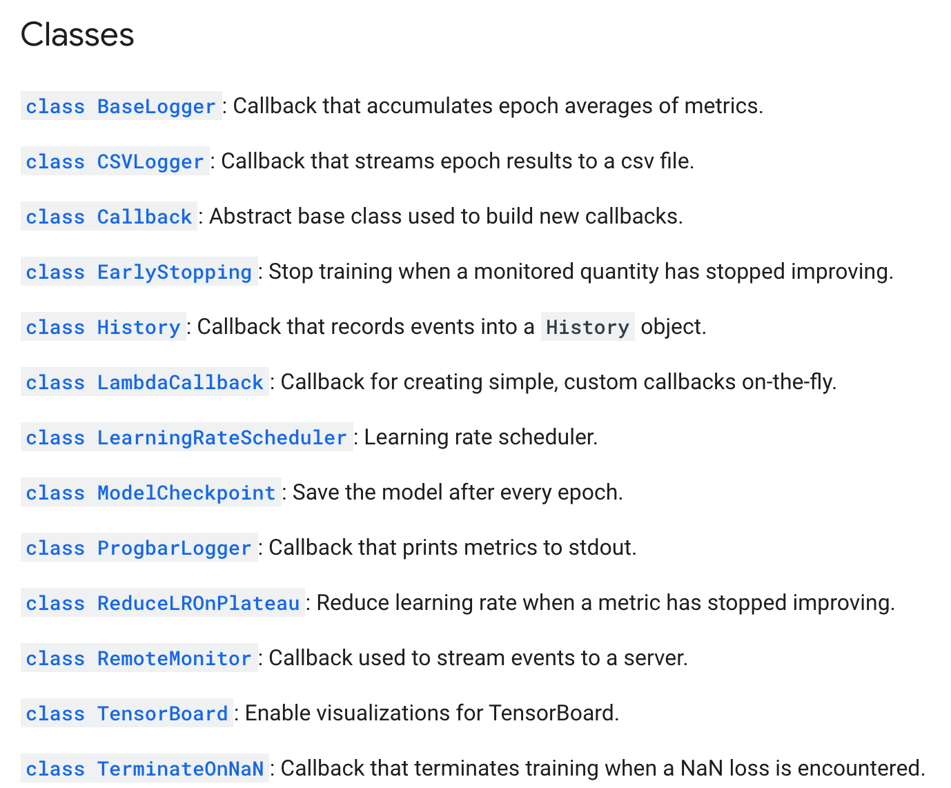
Pre-ready callbacks
https://www.tensorflow.org/versions/r2.0/api_docs/python/tf/keras/callbacks

Slide 37
Multiple Callbacks
Multiple callbacks can be used as a simple list
model.fit(x_train, y_train,
batch_size=64,
steps_per_epoch=5,
epochs=15,
verbose=0,
callbacks=[LossAndErrorPrintingCallback(),
LearningRateScheduler(lr_schedule)])

Slide 38
Keras functional APIs

Slide 39
Keras Functional APIs - an introduction
The Keras functional API is the way to go for defining complex models, such as multi-output models, directed acyclic graphs, models with shared layers or for example residual neural networks.

Slide 40
Example of Keras Functional APIs
Model definition
from keras.layers import Input, Dense
from keras.models import Model
inputs = Input(shape=(784,))
output_1 = Dense(64, activation='relu')(inputs)
output_2 = Dense(64, activation='relu')(output_1)
predictions = Dense(10, activation='softmax')(output_2)
model = Model(inputs=inputs, outputs=predictions)

Slide 41
Example of Keras Functional APIs
Compiling and training remain the same
model.compile(optimizer='rmsprop',
loss='categorical_crossentropy',
metrics=['accuracy'])
model.fit(data, labels)

Slide 42
Keras Functional APIs - everything is a layer
With the functional API, it is easy to reuse trained models: you can treat any model as if it were a layer, by calling it on a tensor. Note that by calling a model you aren't just reusing the architecture of the model, you are also reusing its weights.

Slide 43
Keras Functional APIs - everything is a layer
This can allow, for instance, to quickly create models that can process sequences of inputs. You could turn an image classification model into a video classification model, in just one line.
from keras.layers import TimeDistributed
input_sequences = Input(shape=(20, 784))
processed_sequences = TimeDistributed(model)(input_sequences)

Slide 44
Hardware acceleration

Slide 45
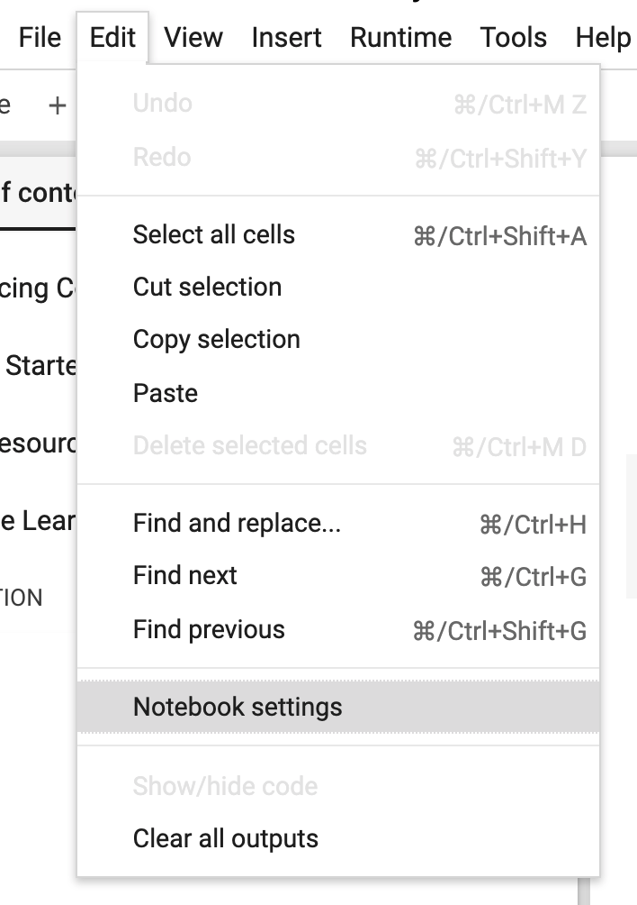
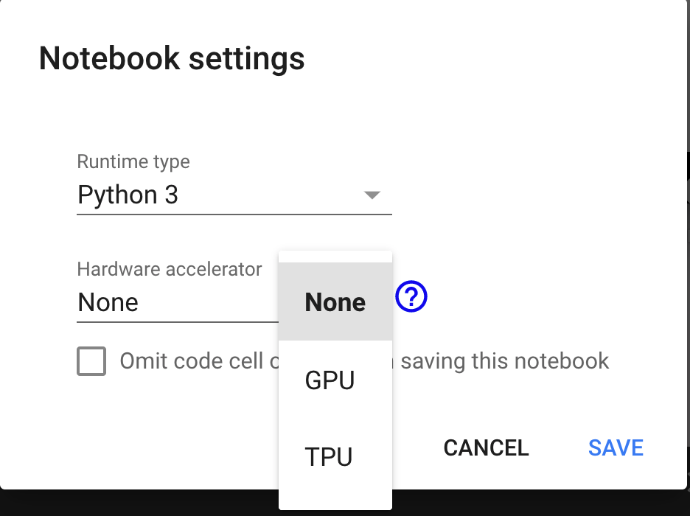
Using hardware acceleration in Google Colab
Changing the Hardware accelerator setting will make restarting the runtime necessary

Slide 46
Testing presence of a GPU
print(tf.test.is_gpu_available())
device_name = tf.test.gpu_device_name()
if device_name != '/device:GPU:0':
raise SystemError('GPU device not found.')
print('Found GPU at: {}'.format(device_name))

Slide 47
Putting operations on a device
with tf.device('/gpu:0'):
# Your code here
with tf.device('/cpu:0'):
# Your code here

